Slide 1

Department of Electronics and Communication Engineering
Acharya Institute of Technology
Soladevanahalli, Bengaluru 560 107
Project Synopsis Presentation on
Predictive Maintenance for Automotive Systems using IoT
Presented by
Group No | Name | USN
13 | ANAND S.S | 1AY21EC012
 | LAXMAN M N | 1AY21EC060
 | KEERTHAN C.K | 1AY22EC402
 | TARUN K.H | 1AY22EC410
Guide Name: Mr. Jagadish M Designation: Assistant Professor
Dept. of ECE

Slide 2
PDM for Automotive Systems using IoT
1. Introduction
2. Problem statement and Objectives
3. Proposed Methodology
4. Deliverables and Impact
5. Individual Responsibilities & Contributions.
6.Gantt Chart
7. References.
Dept. of ECE
Dept. of ECE

Slide 3
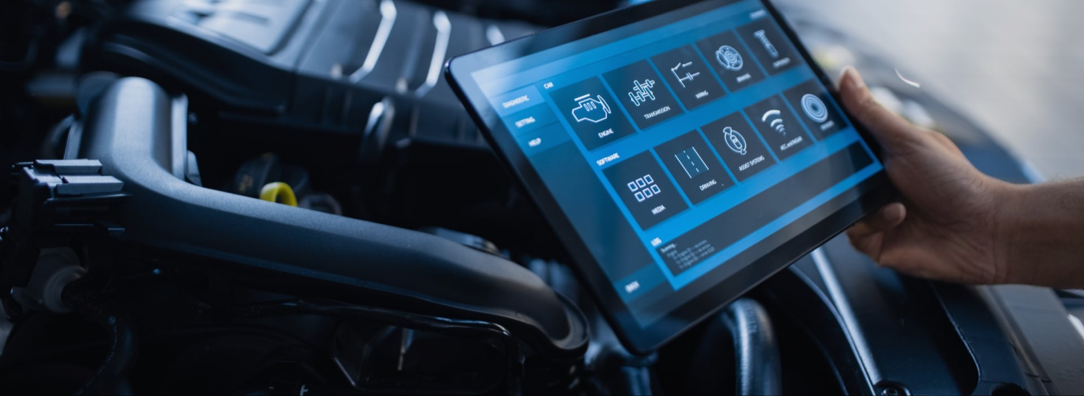

Introduction
Traditional vehicle maintenance methods, such as periodic maintenance and reactive repairs, often lead to unnecessary part replacements, unexpected breakdowns, and high operational costs for vehicle owners.
This project focuses on implementing predictive maintenance for automotive systems using IoT. By leveraging sensor data and real-time monitoring, the system predicts potential failures, reducing downtime and maintenance costs, while improving vehicle performance and safety.

Slide 4
Introduction
Traditional vehicle maintenance methods, such as periodic maintenance and reactive repairs, often lead to unnecessary part replacements, unexpected breakdowns, and high operational costs for vehicle owners.
This project focuses on implementing predictive maintenance for automotive systems using IoT. By leveraging sensor data and real-time monitoring, the system predicts potential failures, reducing downtime and maintenance costs, while improving vehicle performance and safety.

Slide 5
Problem Statement
Unplanned vehicle breakdowns lead to :
costly repairs
unexpected downtime
safety risks.
Present maintenance methods are ineffective because they rely totally on servicing that is scheduled or based on break-down/reactive events.
There is a growing need for an intelligent, real-time solution that predicts failures before they occur, ensuring :
Infallible performance
Safety
Cost-efficiency in automotive systems.
Dept. of ECE

Slide 6
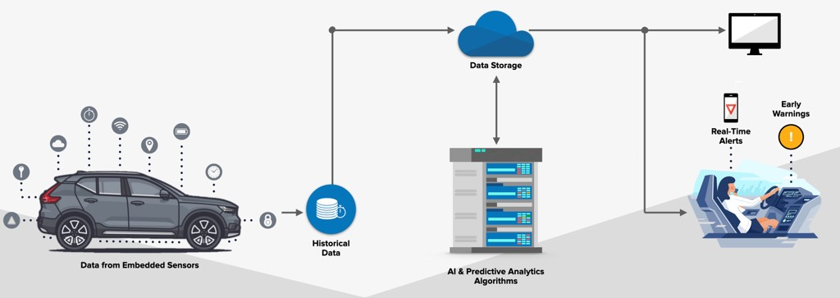
Objectives
Integrate critical sensors for monitoring key vehicle components (e.g., engine temperature, tire pressure, oil quality, battery health, and vibration). Later transmit data to the cloud.
A real-time analytics platform that analyzes sensor data and triggers alerts when parts are predicted to fail soon. Develop a ML model to predict remaining useful life (RUL) of components.
Dept. of ECE

Slide 7
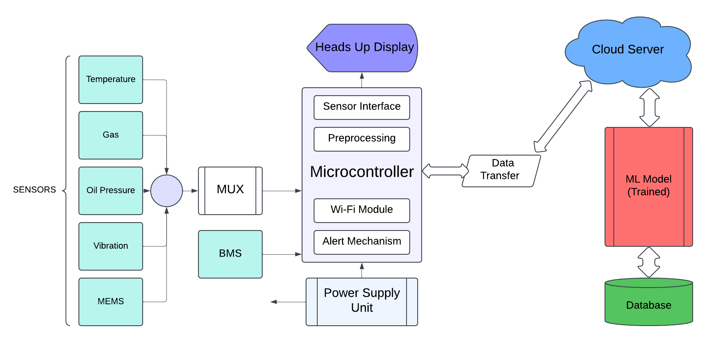
Block Diagram
Dept. of ECE

Slide 8
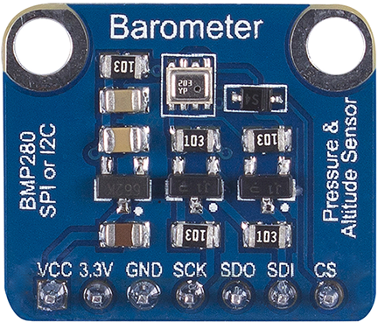
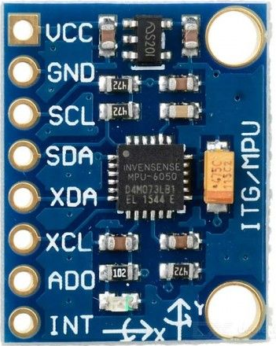
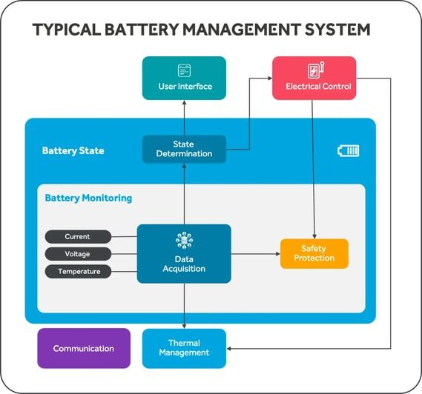
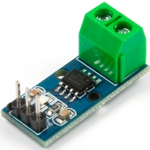
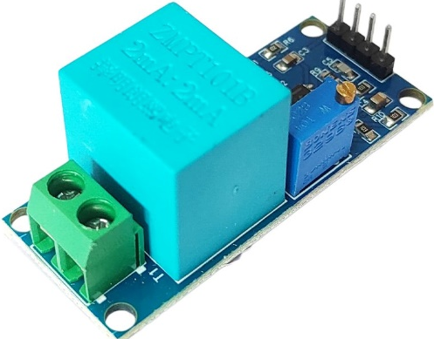
HARDWARE :
1. Engine Components
Parameters to Monitor: Temperature, vibration, pressure
Temperature Sensor (e.g., LM35):
Vibration Sensor (e.g., MPU-6050):
Pressure Sensor (e.g., BMP280)
MEMS (micro-electromechanical systems)
2. Exhaust System
Parameters to Monitor: Temperature, gas emissions
Gas Sensor (e.g., MQ-7 for CO detection)
Temperature Sensor (e.g., Thermocouple)
3. Battery management System
Dept. of ECE

Slide 9

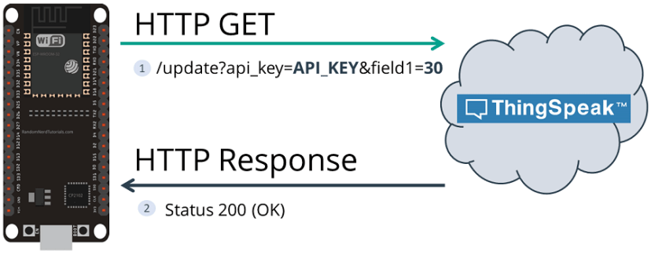
SOFTWARE :
Data Acquisition Software:
Platform: Arduino IDE.
Cloud Platform:
Thing Speak Cloud.
ML and Predictive Analytics:
Python IDLE with JUPYTER Notebook.
Notification System:
Python-script for Alert Mechanism.
Dept. of ECE

Slide 10
Deliverables:
IoT Sensor System: Fully integrated system with sensors monitoring critical vehicle components.
Predictive Maintenance Model: Developed and trained machine learning models for failure prediction.
Alert System: Notification mechanism for maintenance alerts based on predictive insights.
Testing and Validation Report: Evaluation report demonstrating the model’s accuracy and reliability.
Documentation & Publication.
Impact:
Reduced Downtime: Minimizes unexpected vehicle breakdowns through proactive maintenance.
Cost Savings: Lowers maintenance costs by allowing timely interventions and reducing major repairs.
Improved Safety: Enhances vehicle safety by addressing potential failures before they occur.
Optimized Performance: Ensures optimal functioning of vehicle systems through continuous monitoring.
Dept. of ECE

Slide 11
References
Zhang, Y., Li, H., & Tang, X. (2020). Machine learning in autonomous vehicles: A survey. *IEEE Transactions on Intelligent Transportation Systems*, 1-18. doi: [10.1109/TITS.2020.2974558](https://doi.or g/10.1109/TITS.2020.2974558)
Kim, K., et al. (2019). A survey on predictive maintenance in autonomous vehicle systems. *Sensors*, 19(16), 3543. DOI: [10.3390/s19163543](https://doi.org/10.339 0/s19163543)
Surabhi, S. N. D., Shah, C., Mandala, V., & Shah, P. (2024). Range Prediction based on Battery Degradation and Vehicle Mileage for Battery Electric Vehicles. International Journal of Science and Research, 13, 952- 958.
Jiang, R., et al. (2021). Predictive maintenance of autonomous vehicles using machine learning and internet of things. *Sustainable Computing: Informatics and Systems*, 31, 100506. doi: [10.1016/j.suscom.2021.100506](https://doi. org/10.1016/j.suscom.2021.100506)
Wang, Z., et al. (2018). Machine learningbased predictive maintenance for autonomous vehicle systems. In *2018 IEEE Intelligent Vehicles Symposium (IV)* (pp. 1613-1618). doi: [10.1109/IVS.2018.8500624](https://doi.org /10.1109/IVS.2018.8500624)
Dept. of ECE

